Slide 1
CIS 450/550 Final Project Demo
Group XYZH:
Xiao Hu, Yi Xia, Wenhe Zhang, Hiroyuki Kubota

Slide 2
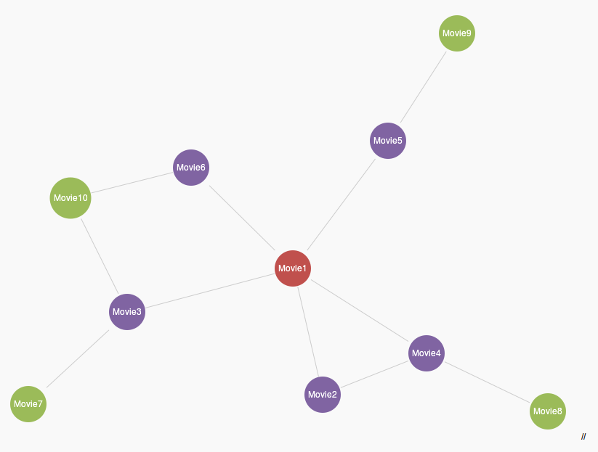
Introduction
Idea of the project:
Movie Recommendation

Slide 3
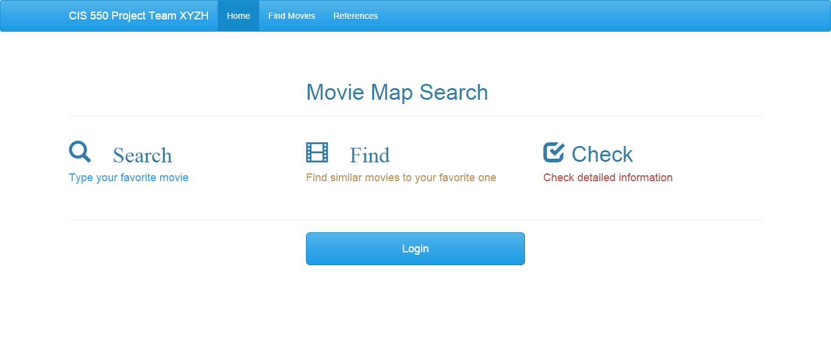
Introduction
Basic features:

Slide 4
Database
Data Cleaning:
Normalization: we split the given database to several SQL tables1.
Convert to MySQL

Slide 5
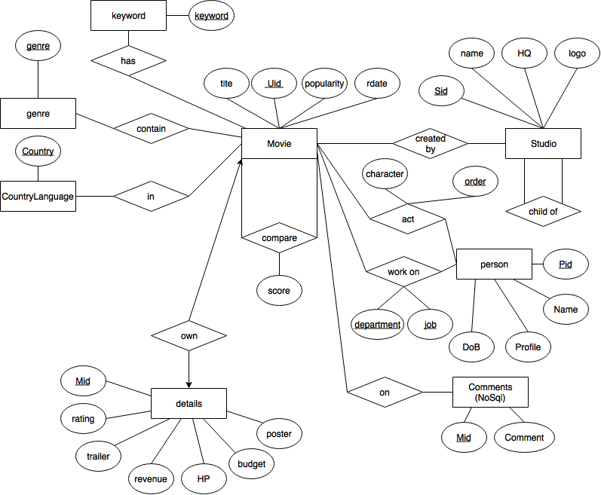
Database
Data Structure:
ER Diagram
Schema
Keys
Constrains

Slide 6
Database
Execute Each Query For 100 Times
Query # | With Index | Without Index
1 | 0m3.721s | 0m3.922s
6 | 0m2.318s | 0m25.634s
9 | 0m1.523s | >10m
Optimization:
Web
Queries
Indexing

Slide 7
Database
Data Cleaning & Optimization (Continued):
Score
Definition:
popularity + release date + (genre + country + keywords)
Normalize before summing up
Queries
Not so efficient in score calculation
Use another application

Slide 8
Architecture & Technologies
Client
Server
AWS (EC2/Ubuntu 14.04)
Browser
MongoDB
Express
JQuery
Node.js
Bootstrap
Arbor.js
type
ahead
Bing Search API
Facebook API
AWS
(Database Instance)
MySQL

Slide 9
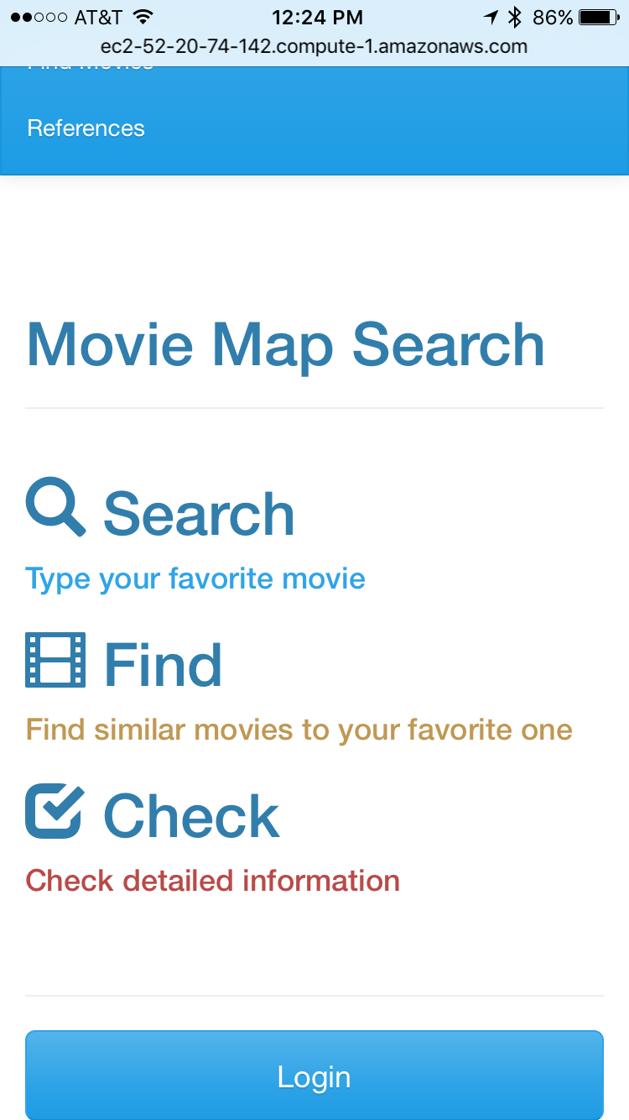
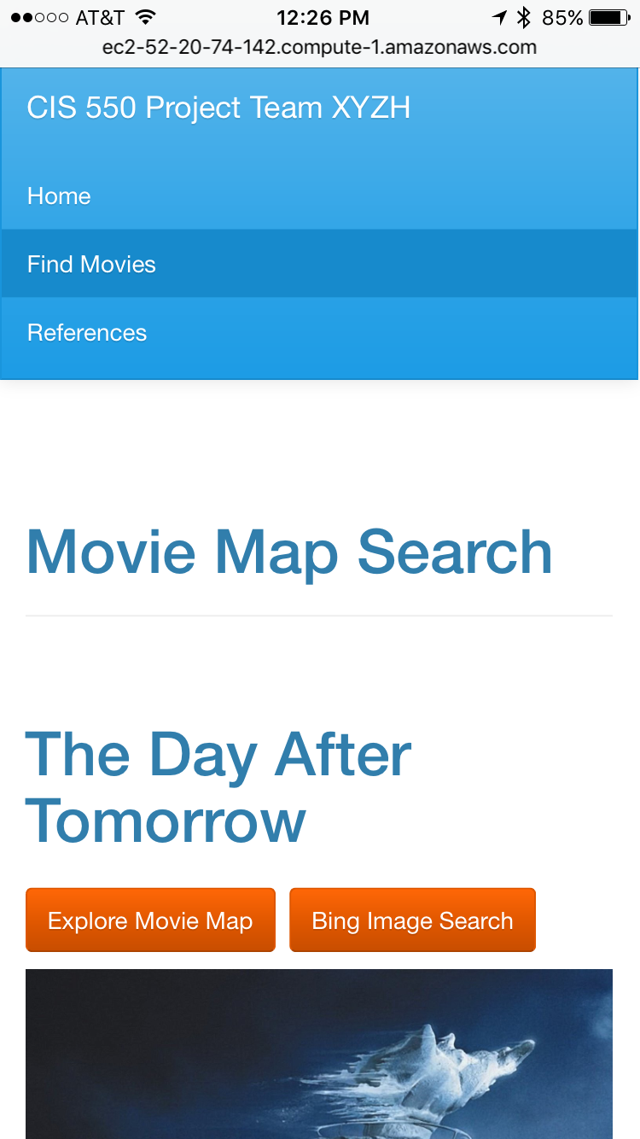
Demo
Show all features:
http://ec2-52-20-74-142.compute-1.amazonaws.com:9000/

Slide 10
Questions
？
Thank You!

Slide 11
Appendix: Query Performance
Query # | With Index | Without Index
1 | 0m3.721s | 0m3.922s
2 | 0m3.408s | 0m3.641s
3 | 0m1.702s | 0m4.308s
4 | 0m2.977s | 0m23.618s
5 | 0m2.340s | 0m2.971s
6 | 0m2.318s | 0m25.634s
7 | 0m5.278s | 0m7.664s
8 | 0m3.386s | 0m7.702s
9 | 0m1.523s | >10m
10 | 0m1.069s | 0m40.513s
11 | 0m0.869s | 2m30.287s
12 | 0m0.851s | 2m11.639s
Command
time ((for i in $(seq 1 100); do echo “{Query}"; done)|mysql --user {username} --host {hostname} –p{password} {dbname} > /dev/null)

Slide 12
Appendix: Queries
<To search movie>
1. Autocomplete for searching a movie title
SELECT title from Movie where title like "%'+req.query.key+'%"
<To find movie>
2. Search typed movie title
SELECT mid, date_format(rdate, '+"'%m/%d/%Y'"+') as reldate from Movie where title="'+req.query.typeahead+'";
3. Search a movie from the movieId (When the above query returned multiple titles)
SELECT mid from Movie where mid="'+temp_Mid+'";
4. Explore similar movie titles from the typed movie title (expect 10 results)
SELECT CMid from Compare where Mid="'+rows[0].mid+'";
5. Explore similar movie titles from the mids obtained from the above query (so this query is executed 10 times) (limit to 2 tuples)
SELECT CMid FROM Compare WHERE Mid="'+ t +'" LIMIT 2;
6. Search movie title from mid (Level0:1, Level1:10, Level2:20)
SELECT mid, title from Movie where Mid="'+ t +'";

Slide 13
Appendix: Queries
<To show detailed info>
7. Search title, rating, trailer, revenue, HP, budget, poster from mid
SELECT M.title, D.rating, D.trailer, D.revenue, D.HP, D.budget, D.poster
FROM Movie M INNER JOIN Details D ON M.Mid = D.Mid\
WHERE M.Mid="'+categoryKey+'";
8. Search Studio name
SELECT S.name as studio
FROM Created_by CB INNER JOIN Studio S ON CB.Sid = S.Sid\
WHERE CB.Mid="'+categoryKey+'";
9. Search director’s name, DoB, profile (image of the director)
SELECT DR.Name as dname, date_format(DR.DoB, '+"'%m/%d/%Y'"+') as ddob, DR.Profile as dprofile, DR.Pid as Did\
FROM Directors DR INNER JOIN Person P ON DR.Pid = P.Pid\
WHERE DR.Mid="'+categoryKey+'";
10. Search Actors’ name, DoB, profile (limit to 14)
SELECT P.Name as actor, date_format(P.DoB, '+"'%m/%d/%Y'"+') as bdate, P.Profile, A.Pid as Aid\
FROM Act A INNER JOIN Person P ON A.Pid = P.Pid\
WHERE A.Mid="'+categoryKey+'"\
ORDER BY A.OrderNum ASC\
LIMIT 14;

Slide 14
Appendix: Queries
<To obtain person’s detailed info>
11. Search director’s info (Name, DoB, Profile, Mids, Tiltes directed by the director)
SELECT P.Name, date_format(P.DoB, '+"'%m/%d/%Y'"+') as bdate, P.Profile,\
M.Mid, M.title\
FROM Person P INNER JOIN Directors D ON D.Pid = P.Pid\
INNER JOIN Movie M ON M.Mid=D.Mid\
WHERE P.Pid="'+categoryKey+'"\
ORDER BY M.popularity DESC;
12. Search actore’s info (Name, DoB, Profile, Mids, Tiltes, Charcter’s name of the actor)
SELECT P.Name, date_format(P.DoB, '+"'%m/%d/%Y'"+') as bdate, P.Profile,\
M.Mid, M.title, A.CharacterName\
FROM Person P INNER JOIN Act A ON A.Pid = P.Pid\
INNER JOIN Movie M ON M.Mid=A.Mid\
WHERE P.Pid="'+categoryKey+'"\
ORDER BY M.popularity DESC;

